Slide 1
Conversations with Canada LMCN Working Group Meeting Recognition of Indigenous Rights & Self-Determination Table Presented by: Battle River IRC August 25, 2022
Notes:
Insert photo?

Slide 2
Today’s Objectives
Where are we at with the Conversations with Canada? (Recap)
What is the role of the Working Group?
Introduction and Presentation from Legal
Where are we going, and how do we get there? Process! (Breakout groups)
What tools do we need to do the work?
Open discussion/Next steps

Slide 3
What is an RIRSD Table? (Recap)
RIRSD Tables are:
RIRSD Tables are not:
Without prejudice (non binding)
Premised on the recognition of section 35 rights
Responsive to the needs and interests of Indigenous groups
Open to a broad range of subject areas of discussions
Supportive of innovation and flexible approaches for reaching agreements
An alternative to litigation
An opportunity to support greater self-determination
Intended to duplicate funding
Intended to focus solely on historical grievances
A way to bypass existing assessment processes related to different types of claims
….but the table can be used to identify existing sources of funding that may be available to LMCN to solve certain issues or concerns.

Slide 4
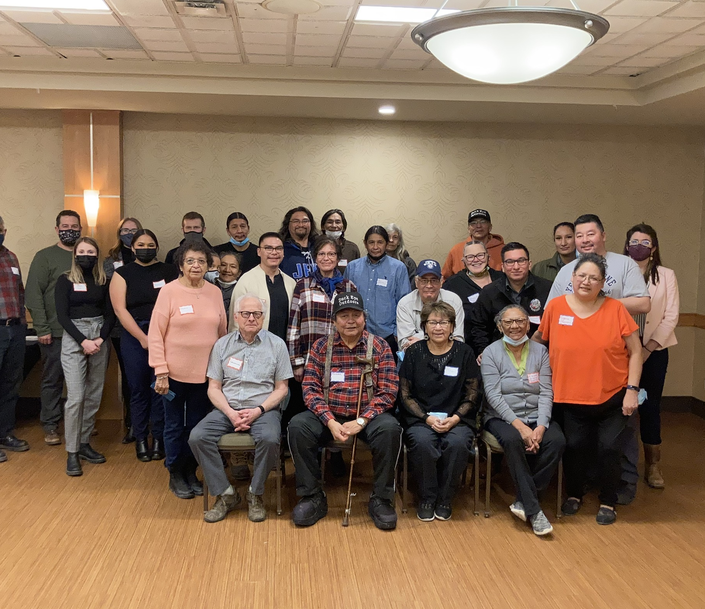
History of Lucky Man’s Table
January 2021: Joint proposal submitted
Feb-Aug 2021: Canada internal approval process and approval letter
October 2021: Workplan jointly agreed to by Battle River IRC and Canada
January 2022: Battle River IRC developed & submitted budget; funding letter of offer issued to LMCN; first negotiators’ meeting
February 2022: Community Winter Forum
Notes:
**Do we need this slide – given Slide 13?

Slide 5
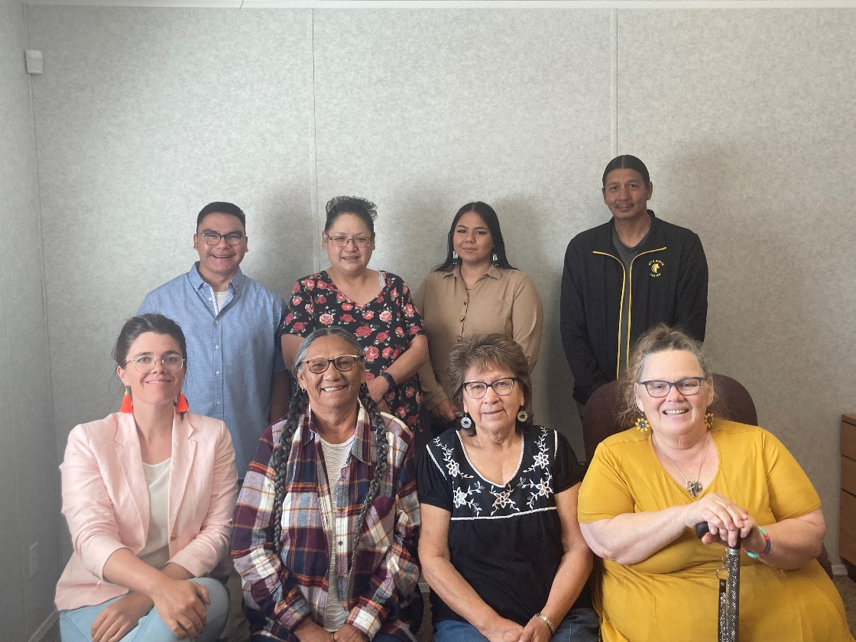
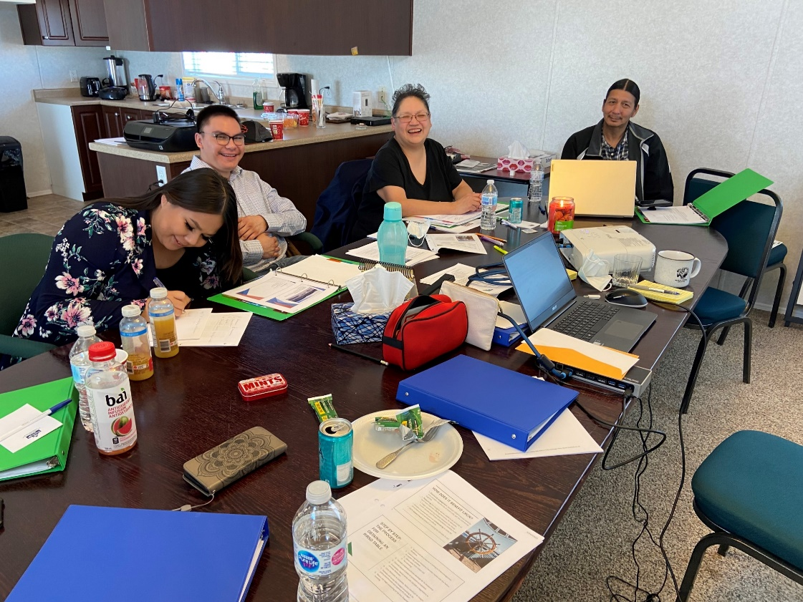
History of Lucky Man’s Table II
March 2022: Finalization of 2022-2023 workplan/budget with Canada; First LMCN-Battle River IRC working group meeting
May 2022: Preparations for next main table meeting
June 2022: LMCN-Canada RIRSD negotiators’ meeting Second LMCN-Battle River IRC working group meeting

Slide 6
Wâhkôhtowin Cree philosophy that refers to the relationships that we have each other and with the land.

Slide 7
Canada-LMCN Topics of Discussion to date
Crown Consultation
Health
Land Use and Cumulative Impacts
Core-Governance
Renewed relationship with Canada
Self-Government Agreement
Exploring Cumulative Impacts
Exploring Treaty Right to Health

Slide 8
Core Governance
Renew and sustain a Nation-to-Nation relationship with Canada.
Restore, protect and preserve the rights, culture, language and way of life of LMCN.
Sense of unity – kinships to all
LMCN wants to explore moving away from some of the constraints of the Indian Act over time, while ensuring that doing so will improve the community’s socio-cultural wellbeing.
Establishment of core governance through an agreement with Canada is the first step in that direction.

Slide 9
Crown Consultation
LMCN seeks to negotiate a consultation protocol with Canada that focuses on consultation triggers and agrees on the consultation process in advance, etc.
LMCN is seeking clarity of process, i.e. when and how Canada delegates consultation to the province, and a role in decision-making within consultation processes.

Slide 10
Land Use and Cumulative Impacts Impacts
LMCN has two priority concerns:
Lack of guidance and consistency regarding delegation of Crown consultation, and related EAs/IAs
No framework for assessing cumulative impacts to the Nation’s rights, culture and way of life
Discuss ways and explore options to support LMCN’s ability to be heard within areas of federal jurisdiction and Crown consultation.

Slide 11
Health
LMCN seeks to explore and better understand the Treaty Right to health.
Identify opportunities to support LMCN’s health development objectives and capacity vis-à-vis funding, access to critical services etc.
LMCN’s goal of being in control of their own health services, taking into account the racism happening in the health care system and the connection to economic capabilities.
LMCN and Canada to work together on a mutual understanding of what the Treaty health clauses mean and how they may affect health delivery
Historical research being done

Slide 12
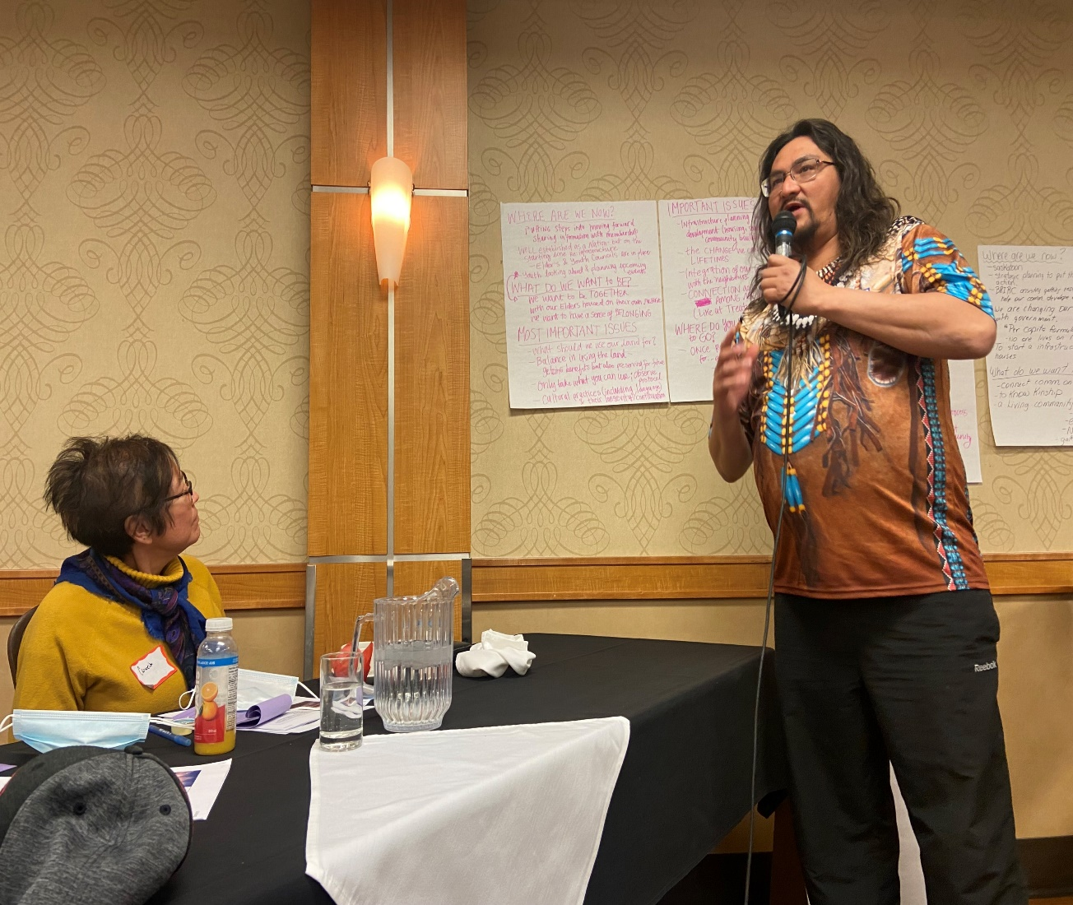
Other Topics for discussion?
Are there other important topics of discussion that need to be considered?
As our discussions on LMCN’s vision for self-determination and self-government advance, we recognize that these topics may broaden and will seek to ensure that they are captured in a MOU between LMCN and Canada.
UNDRIP???

Slide 13
Where are we going?
We are here!
Stage 1
Lucky Man Requests RIRSD Table
Stage 2
Identifying the topics for discussions (What are we going to talk about?)
Stage 3
Co-development of an MOU (How are we going to play in the sandbox together?)
Stage 4
Co-development of a Term Sheet (defining topics of discussion as topics for negotiation & securing a mandate to negotiate)
Stage 5
Negotiation of the Agreement
Stage 8
Implementation of the Agreement
Stage 6
Ratification of the Agreement (Community’s approval of the Agreement and Cabinet Approval)
Stage 7
Implementing Legislation and Effective Date

Slide 14
Where are we going II ?
We are here!
Co-develop the MOU
Negotiation of the Agreement
Ratification of the Agreement
Implementing Legislation and Effective Date
Implementation of the Agreement
Co-Develop the FRAMEWORK
Co-develop the TERM SHEET

Slide 15
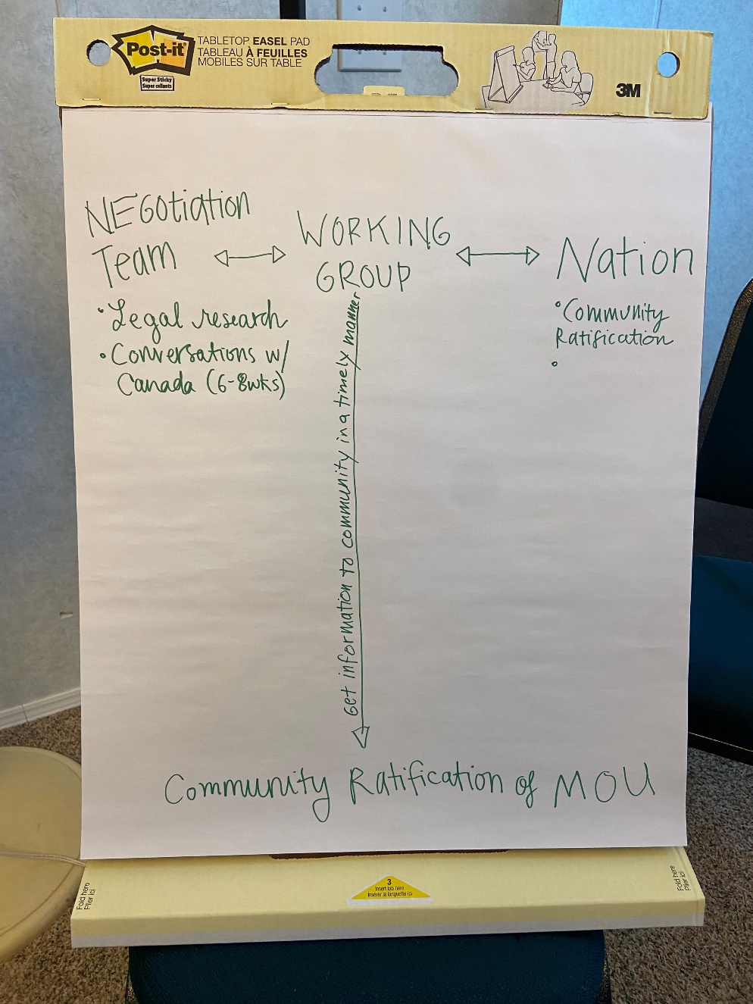
The role of the Working Group?
To be defined by Working Group
*Interactive sheet*

Slide 16
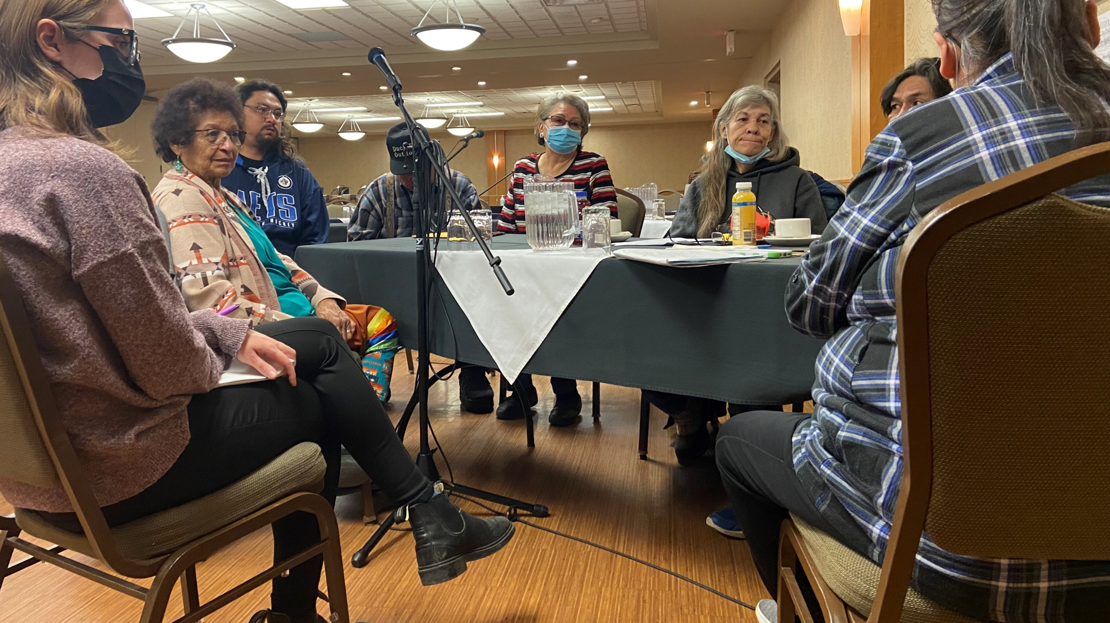
Conversation with our legal negotiator – Bob Freedman

Slide 17
Break out Groups:
Where are we going, and how do we get there? Process
What tools do we need to do the work?
Developing communications tools that work for membership (including Elders, youth)

Slide 18
Open Discussion and Next Steps
Save the date: September ???
Conversations with Membership
Sept 28: Fall Community Meeting
Negotiation Team + Working Group TBD
Comprehensive Community Plan (CPP) and Conversations with Canada (RIRSD) Table
Telephone Survey

